Slide 1
We are revising the content from the Active Earth program
TRACK WITH ME
READ WITH ME
Students will be able to:
Demonstrate their understanding of previous topics

Slide 2
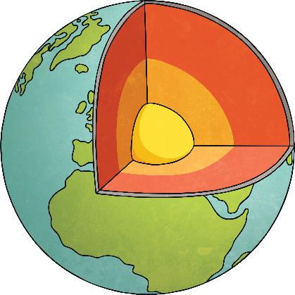
The Structure of the Earth
crust
The structure of the earth is divided into four major components:
the crust,
the mantle,
the outer core, and
the inner core.
Each layer has a unique chemical composition, physical state, and can impact life on Earth's surface
mantle
outer
core
inner
core

Slide 3
The Crust
crust
Thin, solid outer layer of the Earth about 100 kilometres thick.
Moves in sections called plates.
Only a small portion of the upper part of the crust is used by man.

Slide 4
The Mantle
Consists of dense heated rock of around 1000°C that seems to be solid but behaves like a fluid.
Often referred to as a "plastic solid“.
Has a depth of around 2800 km and a pressure of 1 million atm at that depth.
mantle

Slide 5
The Outer Core
Approximately 2200km in depth.
Very dense liquid at high temperatures between 1000 and 2000°C.
Consists mostly of iron and nickel.
outer
core

Slide 6
The Structure of the Earth
Solid layer about 1200 kilometres thick.
Consists of iron with oxygen dissolved in it, silicon and nickel.
Very high temperature of between 8000 - 10000 °C and a very high pressure of around 3 - 5 million atmospheres. It is the tremendous pressure that exists at this depth that keeps the inner core solid.
inner
core

Slide 7
You do – Label the layers of the Earth
crust
mantle
outer
core
inner
core

Slide 8
You Do – Complete the table
Layer | State of matter | Composition
Crust
Mantle
Outer core
Inner Core

Slide 9
You Do – Complete the table
Layer | State of matter | Composition
Crust | solid | Rock – mostly granite
Mantle | plastic solid | Rock – solid and partially melted
Outer core | liquid | Iron and nickel
Inner Core | solid | Iron, dissolved oxygen, nickel and silicon

Slide 10
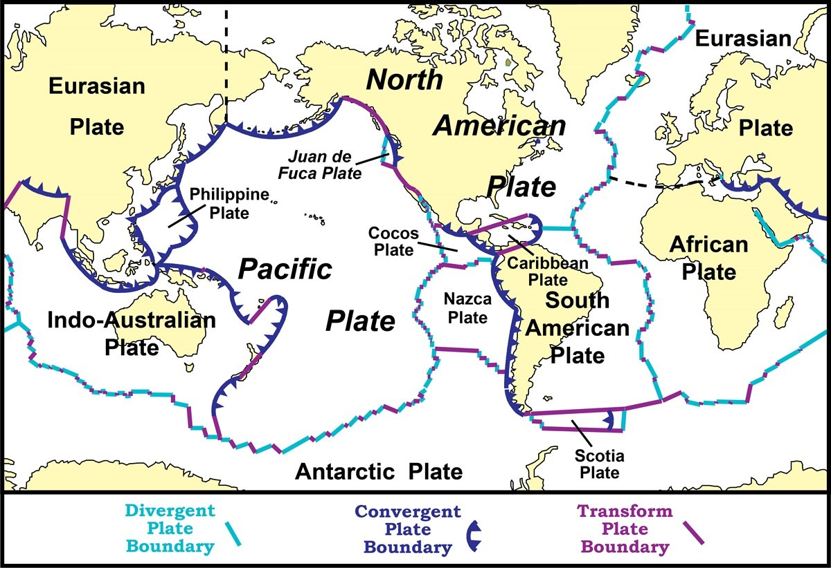
Plate Tectonics
The Earth's crust is broken up into 8 major tectonic plates and many minor plates.
The 8 major plates are:
African plate
Antarctic plate
Eurasian plate
Indo-Australian plate
Pacific plate
Nazca plate
North American plate
South American plate

Slide 11
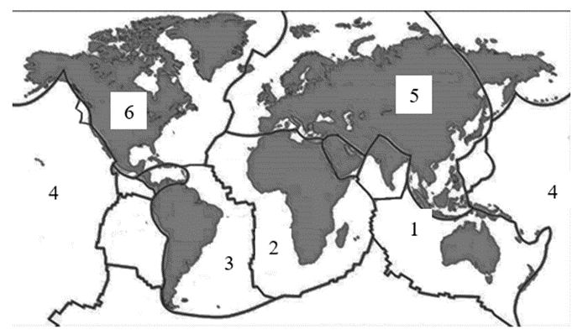
You Do – Label the following tectonic plates

Slide 12
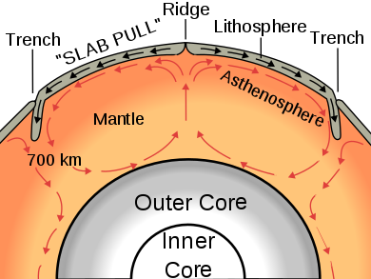
Convection Currents
The core heats the material in the mantle making it become less dense and rise towards the Earth's surface.
This displaces cooler, denser material near the Earth's surface.
This cooler material then sinks back down creating a circular pattern of movement called convection currents.
These currents exert forces on the tectonic plates floating on the semi-fluid upper mantle, causing them to move horizontally.

Slide 13
Fill in the blanks!
Movement of tectonic plates is caused by CONVECTION CURRENTS fuelled by HEAT from the Earth’s core.
Tectonic plates move extremely SLOWLY.
The place where they meet is called a plate BOUNDARY.

Slide 14
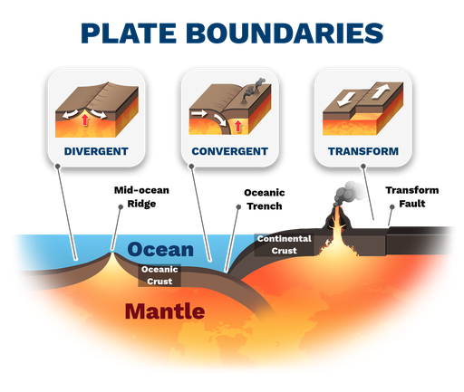
Plate Boundaries
There are 3 types of plate boundaries
Convergent
Divergent
Transform (or conservative)

Slide 15
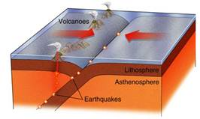
Convergent Plate Boundaries
When two plates move towards each other and collide.
Plates only move a few centimetres each year therefore collisions are very slow and last millions of years.
The denser plate will subduct (move under) the less dense plate.
Landforms created at convergent plate boundaries include:
Volcanoes
Earthquakes
Island arcs
Mountain ranges
Trenches

Slide 16
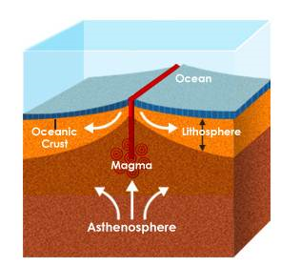
Divergent Plate Boundaries
When two plates move away from one another.
As the plates move apart, molten rock rises and fills the gap between the plates.
The molten rock then cools and becomes new crust.
Landforms that occur at this plate boundary are:
Rift valleys
Trenches
Mid-ocean ridges
Undersea volcanoes

Slide 17
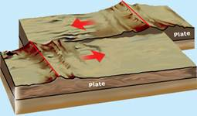
Transform Plate Boundaries
When two plates slide past each other
The plate edges do not slide smoothly, instead they grind past each other in dramatic, sudden movements.
Landforms created include:
Earthquakes
Fault lines

Slide 18
Volcanoes
Volcanoes form when magma reaches the Earth's surface, causing eruptions of lava and ash.
They occur at convergent (destructive) and divergent (constructive) plate boundaries but not at transform (conservative) boundaries.
The Process of Volcano Formation
Magma rises through cracks or weaknesses in the Earth's crust.
Pressure builds up inside the Earth's surface
When the pressure is released, the magma explodes to the surface causing a volcanic eruption.
The lava from the eruption cools forming new rock.
Over time, after several eruptions, the rock builds up and a volcano is formed.

Slide 19
Volcano activity and types
Volcanic activity can be described in three ways:
Active volcanoes are volcanoes that erupt frequently
Dormant volcanoes are temporarily inactive volcanoes but are likely to erupt again
Extinct volcanoes are volcanoes that are likely to never erupt again.
There are two main types of volcanoes. These are:
Strato (composite) volcanoes
Shield volcanoes

Slide 20
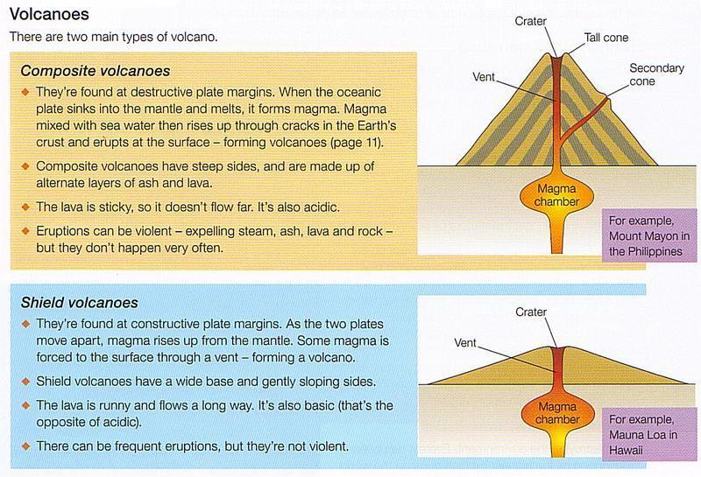

Slide 21
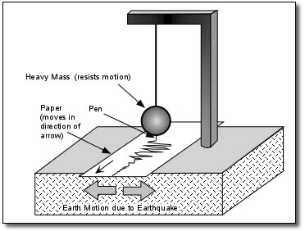
Earthquakes
An earthquake is a sudden and violent shaking of the ground. They occur without warning.
Earthquakes occur when tectonic plates rub against each other beneath the Earth's surface.
Stress then builds up between the plates.
When the stress becomes too great the plates suddenly slip or break, releasing energy in the form of seismic waves.
Earthquakes are measured using a seismometer.

Slide 22
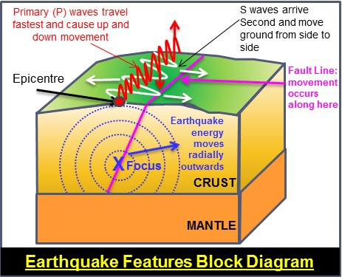
Earthquakes
The exact point an earthquake strikes below the surface is called the focus.
The point on the Earth’s surface where the Earthquake originates is called the epicentre.
The closer you are to the epicentre of an earthquake, the more you feel its effects.
The Richter Scale measures the magnitude or strength of an earthquake from the information provided by the seismograph.

